Slide 2
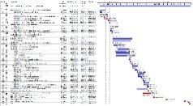
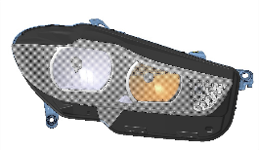
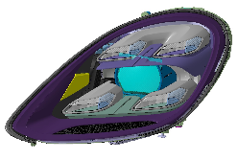
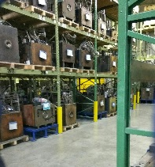
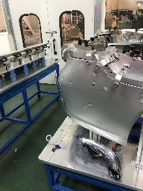
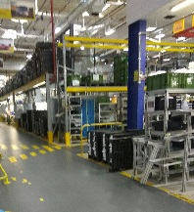
Our approach to vehicle lighting…
At FUTURAEFLUXUM AB, we approach vehicle exterior lighting as extremely demanding and important part of vehicle exterior design and function.
We see exterior lamps on vehicles as:
Highly stylistic elements, that quickly attract attention and must be perfectly made
Subjugated to high legal requirements regarding illumination, electrical conformity, exterior dimensions, recyclability…
Required to withstand unforgiving natural elements and additional human-made influences
Required to perform flawlessly for several years of use
Major factor in good crash safety, especially with pedestrians
Easy to induce customer annoyance, even with slightest loss or degradation of function or appearance
To fullfill all of these expectations, it is imperative, that throughout the development process, lamps are granted proper approach and attention. It begins with good styling input, SOR and RFQ, where foundations are laid for optimal supplier on-board. After that, every department steps in, for longer or shorter time and main development ends with vehicle SORP.
As the saying goes: ”If lamps are ready, we are ready!” Exterior lighting has, due to its complexity and high demands, one of the longest lead-in time of all, that is why it should be constantly closely monitored for timing, styling, price, quality, weight, integration, package space, recyclability and many other aspects.

Slide 3
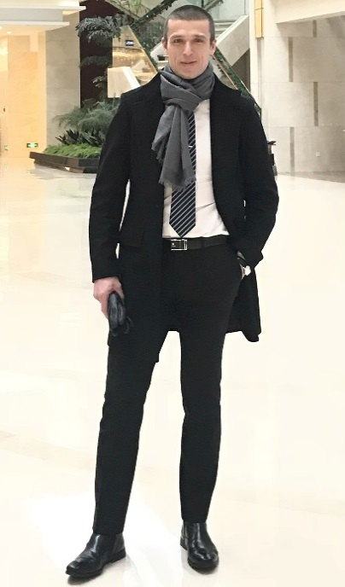
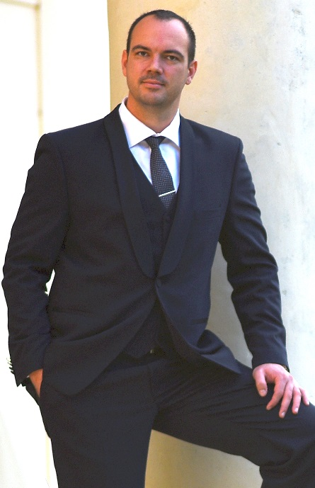
Who we are…
Jenisej LAKOTA, B.Sc.
Mechanical engineer, inventor, entrepreneur, 3D designer, project manager, leader. In past working with/for automotive lighting suppliers, OEM and customers in Europe and China on various projects, involving all lamps for external illumination and various exterior elements, both on ICE and NEV vehicles. Part of NEVS success story in China and broader. Able to provide first-hand technical, styling, production and technology support anywhere in the world.
Vlatko KUKOLJA, M.Sc.
M.Sc. in mechanical engineering with experience in exterior design. Belonging to handful of the best automotive headlamp engineers in Europe with extensive experience on most delicate of lighting projects for most prominent European vehicle manufacturers. In past working for one of three of the best automotive lighting suppliers in the world on lighting projects for nearly all world´s markets.

Slide 4
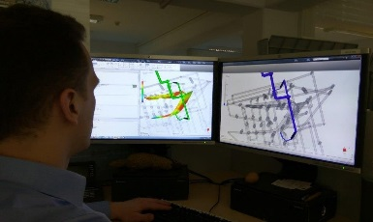
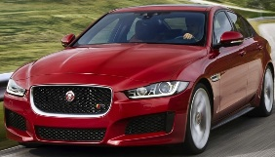
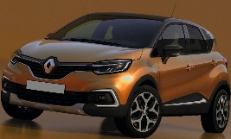
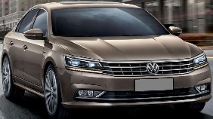
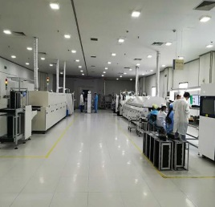
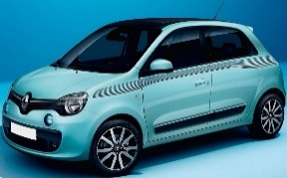
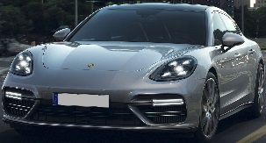
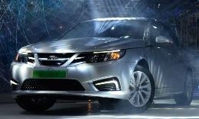
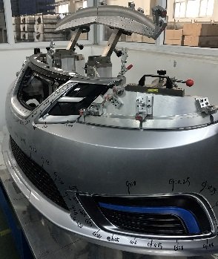
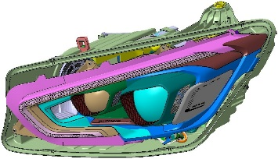
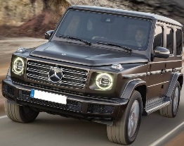
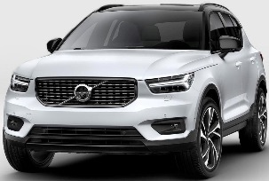
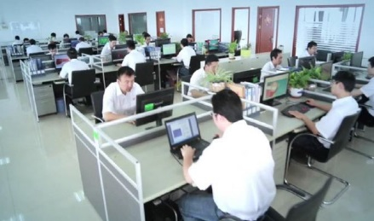
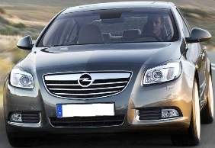
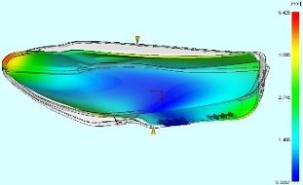
Worldwide community and knowledge…
B
Our work on projects, along with joining major lighting suppliers and OEM, have brought us extensive experience and knowledge about performing for different customers in various cultures and environements. It also enabled us, to bring together and cooperate very closely with the lighting design experts and suppliers in Europe and China. Such background creates lean and responsive network, which is able to provide you with array of benefits.

Slide 5
Our mission…
We can provide you with all kinds of direct support. In cooperation with our partners, complete development process for vehicle exterior lighting is available. Should you choose so, we can together evaluate the possibilities of lighting development and/or production at our partners in China, where price-performance ratio is only one thing to consider.
Whatever the cooperation should you require and we choose to accept it, it will become our priority to make it come to life as you would like. It is important to know, that earlier in project we join, more effect we can provide. Result oriented go-makers with positive customer attitude as we are, you can be confident, that we will find a way to meet your expectations.
Our customer benefits are:
All sorts of lighting (automotive, home, marine, street, aerospace…)
Experience with OEM, Tier 1 and Tier 2
3D design of components and systems, made of thermoplasts, duroplasts and sheetmetals
DFA, DFM, DFMEA, SFMEA, PFMEA support
All simulations (optical, CFD, FEM, kinematics, mouldflow…)
Project managing on all levels
Creative design support and evaluations
Technical support and consulting on component and system levels (tooling, materials, assembly, used technologies…)
Crisis management and all resolvement support
SOR (Statement of requirements) support
RFI and RFQ support, along with supplier feedback evaluation
Project transfer evaluation and support
Various innovations evaluation, support and proposals, extending beyond lighting
Root cause analysis on components, products and projects
Health evaluations of on-going projects, their price and design efficiency and transparency
Readiness evaluation and preparations of components and parts for different project stages
Providing better price and performance of projects, cooperating with our suppliers in PR of China
Connecting European and Chinese suppliers and OEMs
On-site support, wherever and anytime in the world, instantly and without time limit
Industrialization and build support
Support and solutions in project managing, design, assembly, quality, purchasing…
Knowledge and experience usable not only in lighting, but also on other fields and areas of various industries (medical, kitchen appliances, workspace, personal use, tools, gadgets, various innovations...)

Slide 6
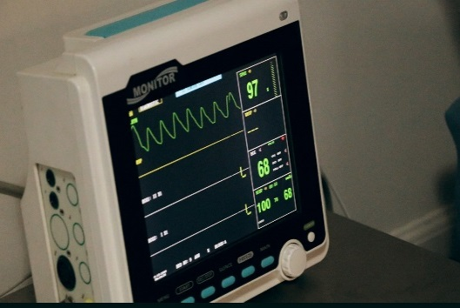
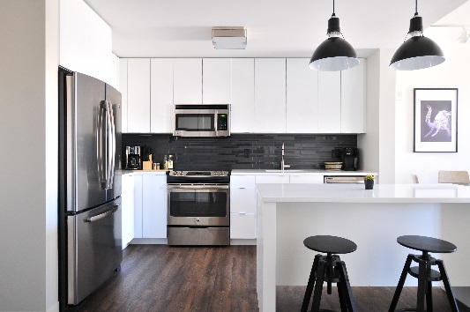
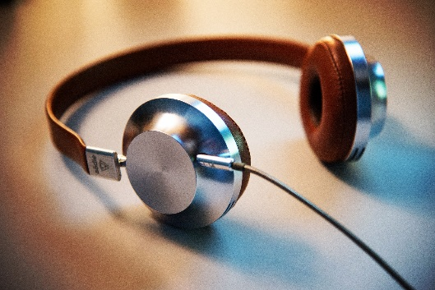
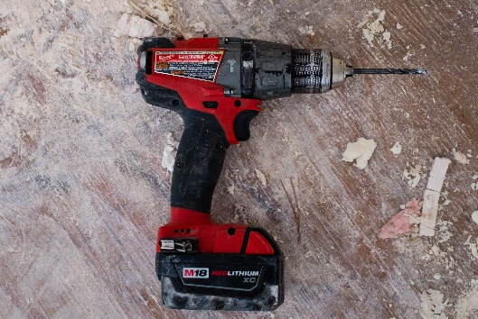
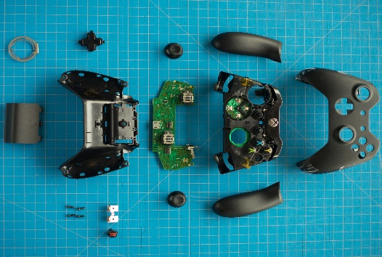
Moving the boundaries…
With our knowledge and experience, we are confident, that some boundaries can be moved and goals pushed further. That is why we believe, it also makes sense to look for challenges elsewhere, in other industries. Good 3D design, smooth project flow and optimal choice of suppliers will always save time, money and resources. We dare to venture into different worlds: personal use, innovations, gadgets, medical, kitchen appliances, power tools, entertainment… Array of services we offer to automotive industry does not end there; we see challenge as opportunity to grow and expand our knowledge and experience.
Dare with us, we will surprise you!

